Slide 1
04: FUNCTION

Slide 2
Modular Programming
Modular programming: breaking a program up into smaller, manageable functions or modules
Function: a collection of statements to perform a task
Motivation for modular programming:
  Improves maintainability of programs
  Simplifies the process of writing programs

Slide 3
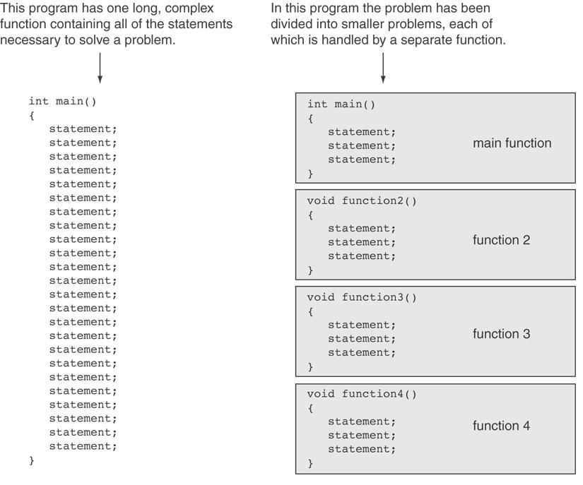

Slide 4
Function
A collection of statements that performs a specific task.
Commonly used to break a problem down into small manageable pieces.
In C++, there are 2 types of function:
  Library functions
  User-defined functions

Slide 5
Library Functions
“Built-in" functions that come with the compiler.
The source code (definition) for library functions does NOT appear in your program.
To use a library function, you simply need to include the proper header file and know the name of the function that you wish to use.
  #include compiler directive

Slide 6
Library Functions (cont.)
Libraries under discussion at this time:
Compiler directive | Purpose
<cctype> | Character classification and conversion
<cmath> | Math functions
<cstdlib> | Data conversion
<ctime> | Time functions

Slide 7
Library Functions (cont.)
A collection of specialized functions.
C++ promotes code reuse with predefined classes and functions in the standard library
The functions work as a black box:
x=4
sqrt(x)
2

Slide 8
Math Functions
Required header: #include <cmath>
Example functions
Function | Purpose
abs(x) | returns the absolute value of an integer.
pow(x,y) | calculates x to the power of y. If x is negative, y must be an integer. If x is zero, y must be a positive integer.
pow10(x) | calculates 10 to the power of x.
sqrt(x) | calculates the positive square root of x. (x is >=0)

Slide 9
Library Functions: Example 1
#include <iostream>
#include <cmath>
using namespace std;
int main()
{
double area, radius;
cout<< "This program calculates the area of a circle.\n";
cout<<"What is the radius of the circle? ";
cin>>radius;
area=3.14159 * pow(radius,2.0);
cout<<"The area is " << area <<endl;
system (“pause”);
return 0;
}

Slide 10
Library Functions: Example 2
#include <iostream>
#include <cmath>
using namespace std;
main(){
int nom1,nom2, result;
cout<<"Enter two numbers";
cin>>nom1>>nom2;
if ((nom1<0)||(nom2<0))
{ cout<<“negative number/s";
}
else
{
result= sqrt(nom1 + nom2);
cout<<"The square root of "<< nom1+nom2 << "is" << result;}
}

Slide 11
More Mathematical Functions
Require cmath header file
Take double as input, return a double
Commonly used functions:
sin | Sine
cos | Cosine
tan | Tangent
sqrt | Square root
log | Natural (e) log
abs | Absolute value (takes and returns an int)

Slide 12
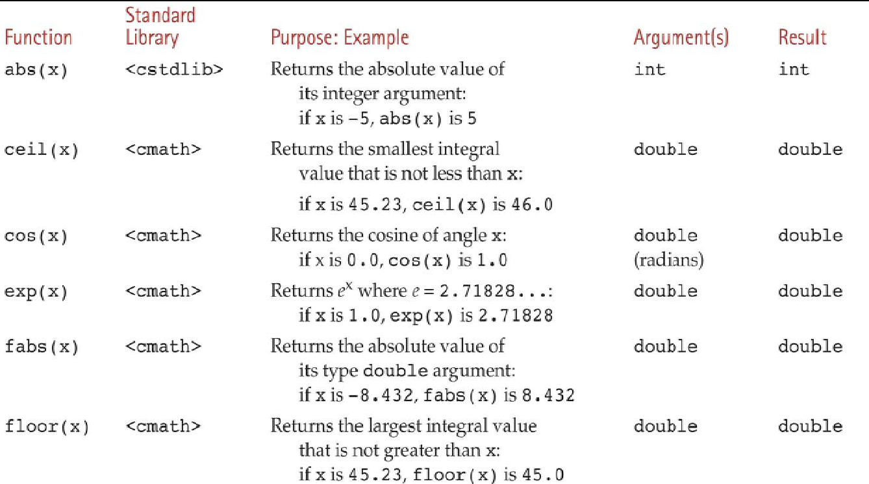
More Mathematical Functions
<cmath>

Slide 13
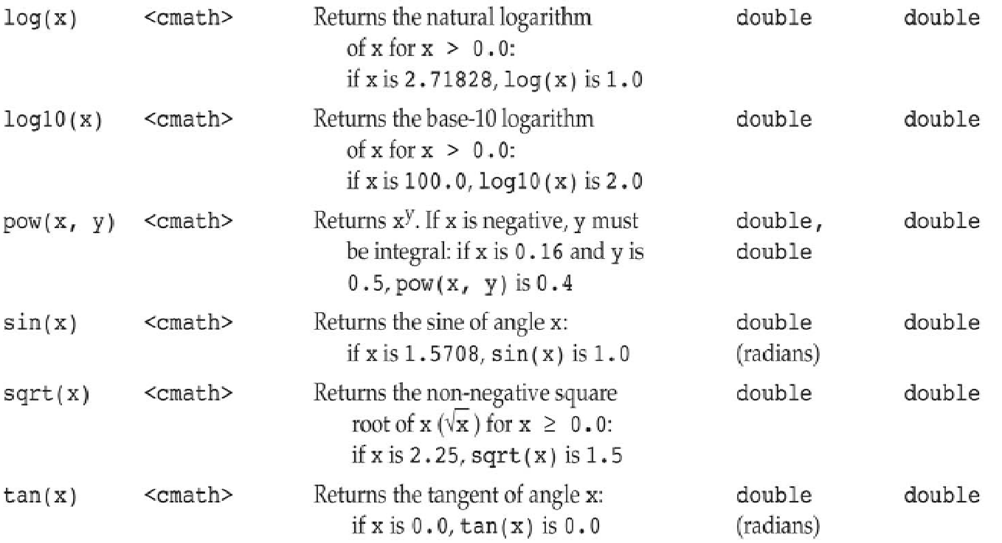
More Mathematical Functions

Slide 14
General Purpose Library
These require cstdlib header file
rand(): returns a random number (int) between 0 and the largest int the compute holds. Yields same sequence of numbers each time program is run.
srand(x): initializes random number generator with unsigned int x

Slide 15
Character Manipulation
The C++ library provides several functions for testing characters.
To use these functions, you must include the cctype header file.
FUNCTION | MEANING
isalpha | true if arg. is a letter, false otherwise
isalnum | true if arg. is a letter or digit, false otherwise
isdigit | true if arg. is a digit 0-9, false otherwise
islower | true if arg. is lowercase letter, false otherwise
isprint | true if arg. is a printable character, false otherwise
ispunct | true if arg. is a punctuation character, false otherwise
isupper | true if arg. is an uppercase letter, false otherwise
isspace | true if arg. is a whitespace character, false otherwise

Slide 16
Example – Character Testing
#include <iostream>
#include <cctype>
using namespace std;
int main()
{
char input;
cout<<"Enter any character: ";
cin.get(input);
if (isalpha(input)){
cout.put(input);
cout<<"It is an alphabet";}
if (isdigit(input))
cout<<"It is a digit";
if (islower(input))
cout<<"The letter entered is lowercase";
if (isupper(input))
cout<<"The letter entered is uppercase";
return 0;
}

Slide 17
Exercise 01
Write a program with if statements that will display the word “digit” if the variable ch contains numeric data, or display the word “letter” if the variable ch contains alphabet data. Otherwise, it should display “special character”

Slide 18
Character Case Conversion
Require cctype header file
Functions:
  toupper: if char argument is lowercase letter, return uppercase equivalent; otherwise, return input unchanged
  char ch1 = 'H';
  char ch2 = 'e';
  char ch3 = '!';
  cout << toupper(ch1); // displays 'H'
  cout << toupper(ch2); // displays 'E'
  cout << toupper(ch3); // displays '!'

Slide 19
Character Case Conversion
Functions:
  tolower: if char argument is uppercase letter, return lowercase equivalent; otherwise, return input unchanged
  char ch1 = 'H';
  char ch2 = 'e';
  char ch3 = '!';
  cout << tolower(ch1); // displays 'h'
  cout << tolower(ch2); // displays 'e'
  cout << tolower(ch3); // displays '!'

Slide 20
Example – Character Case Conversion
#include <iostream>
#include <cctype>
using namespace std;
int main()
{
char input[15];
cout<<"Enter a name ";
cin>>input;
for(int i=0;input[i] != '\0';i++)
input[i]=toupper(input[i]);
cout<<"The name in upper case is:" << input;
return 0;
}

Slide 21
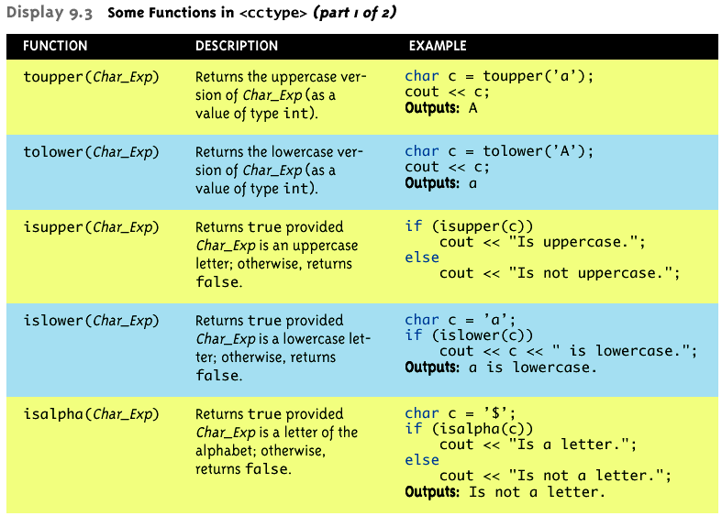
Character Manipulating Functions

Slide 22
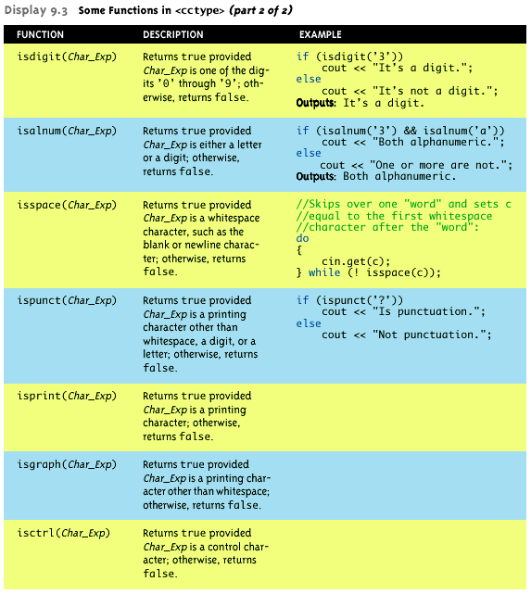

Slide 23
Exercise 02
Write a program to toggle the contents of a string character from lower to upper case or vice versa.

Slide 24
Review of the Internal Storage of C-Strings
C-string: sequence of characters stored in adjacent memory locations and terminated by NULL character
String literal (string constant): sequence of characters enclosed in double quotes " " :
"Hi there!"
H
i
t
h
e
r
e
!
\0

Slide 25
Review of the Internal Storage of C-Strings
Array of chars can be used to define storage for string:
const int SIZE = 20;
char city[SIZE];
Leave room for NULL at end
Can enter a value using cin or >>
  Input is whitespace-terminated
  No check to see if enough space
For input containing whitespace, and to control amount of input, use cin.getline()

Slide 26
C-Strings Manipulation Functions
The C++ library has numerous functions for handling C-strings.
Requires cstring header file be included.
Functions take one or more C-strings as arguments. Can use:
  C-string name
  pointer to C-string
  literal string

Slide 27
Functions for C-Strings
Functions:
  strlen(str): returns length of C-string str
  char city[SIZE] = "Missoula";
  cout << strlen(city); // prints 8
  strcat(str1, str2): appends str2 to the end of str1
  char location[SIZE] = "Missoula, ";
  char state[3] = "MT";
  strcat(location, state);
  // location now has "Missoula, MT"

Slide 28
Function for C-Strings
Functions:
  strcpy(str1, str2): copies str2 to str1
  const int SIZE = 20;
  char fname[SIZE] = "Maureen", name[SIZE];
  strcpy(name, fname);
  Note: strcat and strcpy perform no bounds checking to determine if there is enough space in receiving character array to hold the string it is being assigned.

Slide 29
Function for C-Strings
Functions:
  strstr(str1, str2): finds the first occurrence of str2 in str1. Returns a pointer to match, or NULL if no match.
    char river[] = "Wabash";
    char word[] = "aba";
    cout << strstr(state, word);
    // displays "abash"

Slide 30
Comparing C-Strings
Also cannot use operator ==
char aString[10] = “Hello”;
char anotherString[10] = “Goodbye”;
  aString == anotherString; // NOT allowed!
Must use library function again:
if (strcmp(aString, anotherString))
cout << “Strings NOT same.”;
else
cout << “Strings are same.”;

Slide 31
Working with C-Strings - Example
#include <iostream>
#include <cstring>
using namespace std;
int main()
{ char reply;
char garment[]="overcoat";
cout<<"Is it raining outside? Answer y/n\n";
cin>>reply;
if(reply=='y')
strcpy(garment,"raincoat");
cout<<"before you go out today take your "<<garment;
return 0;
}

Slide 32
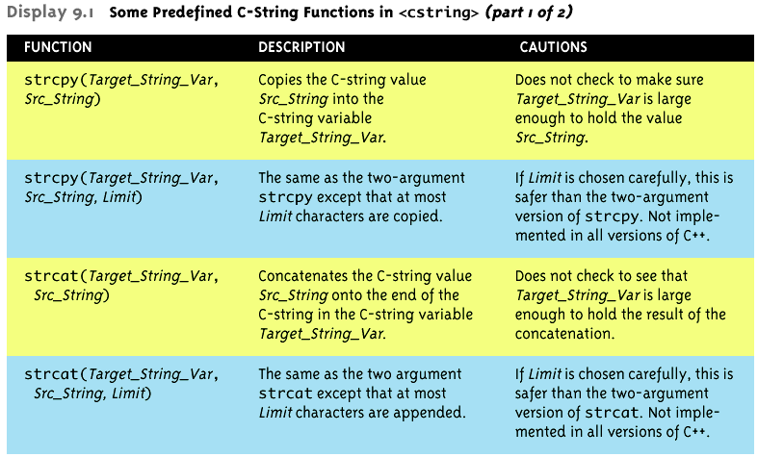
Predefined C-String Functions

Slide 33
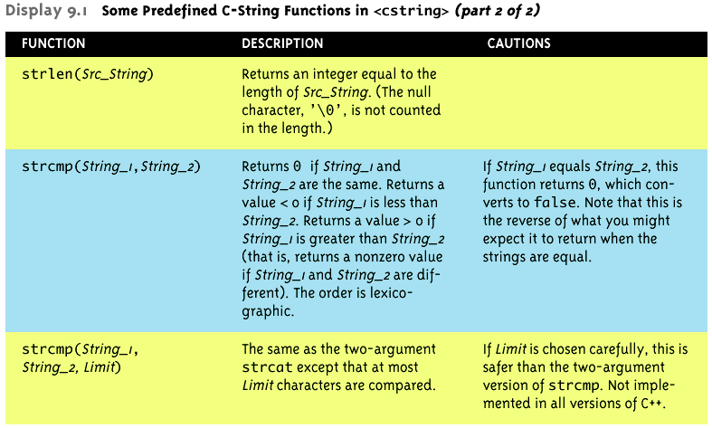
Predefined C-String Functions

Slide 34
String/Numeric
Conversion Functions
These functions convert between string and numeric forms of numbers
Need to include cstdlib header file
FUNCTION | PARAMETER | ACTION
atoi | C-string | converts C-string to an int value, returns the value
atoll strtol | C-string | converts C-string to a long value, returns the value
atof strtod | C-string | converts C-string to a double value, returns the value

Slide 35
String/Numeric
Conversion Functions
atoi converts alphanumeric to int
atol converts alphanumeric to long
atof converts a numeric string to a double
if C-string being converted contains non-digits, results are undefined
  function may return result of conversion up to first non-digit
  function may return 0

Slide 36
String/Numeric
Conversion Functions
Examples:
  int number;
  long lnumber;
  double dnumber;
  number = atoi("57");
  lnumber = atol("50000");
  dnumber = atof(“590.55”);

Slide 37
User-Defined Functions
User-defined functions are created by you, the programmer.
Commonly used to break a problem down into small manageable pieces.
You are already familiar with the one function that every C++ program possesses: int main()
  Ideally, your main() function should be very short and should consist primarily of function calls.
Main Program
Function 1
Function 2
Function 3

Slide 38
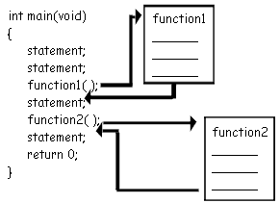
Defining and Calling Functions
Every functions must have:
  Function call: statement causes a function to execute
  Function definition: statements that make up a function
Function definition
Function call

Slide 39
Function Definition
Definition includes:
  return type: data type of the value that function returns to the part of the program that calls it
  name: name of the function. Function names follow same rules as variables
  parameter list: variables containing values passed to the function
  body: statements that perform the function’s task, enclosed in {}

Slide 40
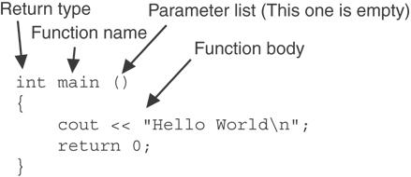
Function Definition (cont.)
The general form of a function definition in C++ is as follows:
function-returntype function-name( parameter-list )
{
local-definitions;
function-implementation;
}
Note: The line that reads int main() is the function header.

Slide 41
Function Return Type
If a function returns a value, the type of the value must be indicated:
int main()
If a function does not return a value, its return type is void:
void printHeading()
{
cout << "Monthly Sales\n";
}

Slide 42
Calling a Function
To call a function, use the function name followed by () and ;
printHeading();
When called, program executes the body of the called function
After the function terminates, execution resumes in the calling function at point of call.

Slide 43
The Flowchart
Start
displayMessage()
print “Hello from main”
print “Hello from the function displayMessage”
displayMessage()
return
print “Back in function main again”
End

Slide 44
The Pseudo Code
Start
Print “Hello from main”
Call displayMessage()
Print “Back in function main again”
End
displayMessage():
  Print “Hello from the function displayMessage”
  Return

Slide 45
The Structure Chart
main_program
displayMessage

Slide 46
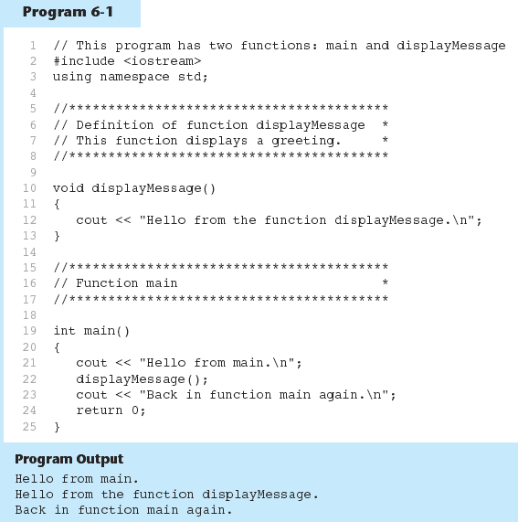
Calling a Function - Example
Function
definition
Function call

Slide 47
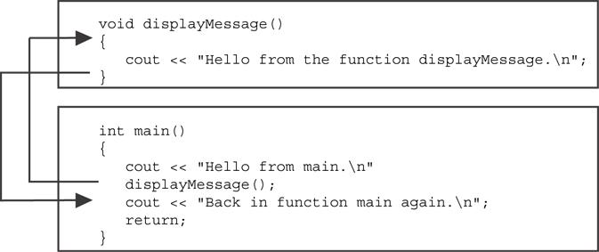
Flow of Control in Program 6-1

Slide 48
User-Defined Functions:
Example 2
01 #include <iostream>
02 #include <cmath>
03 using namespace std;
04
05 float distance(float x, float y)
06 { float dist;
07 dist = sqrt(x * x + y * y);
08 return dist;
09 }
10
11 int main()
12 {
13 float x,y,dist;
14 cout << "Testing function distance(x,y)" << endl;
15 cout << "Enter values for x and y: ";
16 cin >> x >> y;
17 dist = distance(x,y);
18 cout << "Distance of (" << x << ',' << y << ") from origin is "
<< dist << endl << "Tested" << endl;
19 return 0;
20 }

Slide 49
Calling Functions
main can call any number of functions
Functions can call other functions
Compiler must know the following about a function before it is called:
  name
  return type
  number of parameters
  data type of each parameter

Slide 50
In-Class Exercise
Which of the following function headers are valid? If they are invalid, explain why.
  one (int a, int b)
  int thisone(char x)
  char another (int a, b)
  double yetanother

Slide 51
Function Prototypes
Ways to notify the compiler about a function before a call to the function:
  Place function definition before calling function’s definition
  Use a function prototype (function declaration) – like the function definition without the body
    Header: void printHeading()
    Prototype: void printHeading();

Slide 52
User-Defined Functions:
Function Prototypes
01 #include <iostream>
02
03 void first();
04 void second();
05
06 int main()
07 {
08 cout<< "Starting in main function \n";
09 first();
10 second();
11 cout<<"Control back to main\n"; return 0;
12 }
13
14 void first()
15 { cout<<"Inside the first function\n";}
16
17 void second()
18 { cout<<"Inside the second function\n";}
Function prototypes

Slide 53
Structured Chart
Main Program
first()
second()

Slide 54
Prototype Notes
Place prototypes near top of program
Program must include either prototype or full function definition before any call to the function – compiler error otherwise
When using prototypes, can place function definitions in any order in source file

Slide 55
User-Defined Functions:
Functions with No Parameters
01 #include <iostream>
02 using namespace std;
03 void printhi();
04 int main(){
05 cout << "Testing function printhi()" << endl;
06 printhi();
07 cout << "Tested" << endl; return 0;
08 } // End of main
09
10 // Function Definitions
11 void printhi()
12 {
13 cout << "Hi \n";
14 }

Slide 56
Sending Data into a Function
Can pass values into a function at time of call:
  c = pow(a, b);
Values passed to function are arguments
Variables in a function that hold the values passed as arguments are parameters

Slide 57
A Function with a
Parameter Variable
01 void displayValue(int num)
02 {
03 cout << "The value is " << num << endl;
04 }
The integer variable num is a parameter.
It accepts any integer value passed to the function.

Slide 58
User-Defined Functions: Functions with Parameter and No Return Values (1)
01 #include <iostream>
02 using namespace std;
03 void printhi(int);
04
05 int main(){
06 int n;
07 cout <<"Enter a value for n: ";
08 cin >> n;
09 printhi(n);
10 cout << "Tested \n"; return 0; }
11
12 void printhi(int n)
13 {
14 int i;
14 for (i = 0; i < n; i++)
15 cout << "Hi \n";
16 }

Slide 59
The Structure Chart
main_program
n
printHi

Slide 60
User-Defined Functions: Functions with Parameter and No Return Values (2)
01 #include <iostream>
02 using namespace std;
03
04 void displayValue(int);
05
06 int main()
07 {
08 cout<<"Passing number 5 to displayValue\n";
09 displayValue(5);
10 cout<<"Back in main\n"; return 0;
11 }
12
13 void displayValue(int n)
14 {
15 cout<<"The value is " << n << endl;
16 }

Slide 61
Other Parameter Terminology
A parameter can also be called a formal parameter or a formal argument
An argument can also be called an actual parameter or an actual argument

Slide 62
Parameters, Prototypes, and Function Headers
For each function argument,
  the prototype must include the data type of each parameter inside its parentheses
  the header must include a declaration for each parameter in its ()
  void evenOrOdd(int); //prototype
  void evenOrOdd(int num) //header
  evenOrOdd(val); //call

Slide 63
Function Call Notes
Value of argument is copied into parameter when the function is called
A parameter’s scope is the function which uses it
Function can have multiple parameters
There must be a data type listed in the prototype () and an argument declaration in the function header () for each parameter
Arguments will be promoted/demoted as necessary to match parameters

Slide 64
In-Class Exercise
What is the output of this program?
01 #include <iostream>
02 using namespace std;
03 // Function prototype
04 void showDouble(int);
05
06 int main(){
07 int num;
08 for (num = 0; num < 10; num++)
09 showDouble(num);
10 system(“pause”);
11 return 0;
12 }
13
14 //Definition of function
15 void showDouble(int value) {
16 cout<<value <<"\t“;
17 cout << (value * 2)<< endl;
18 }

Slide 65
User Defined Functions: Passing Multiple Arguments
When calling a function and passing multiple arguments:
  the number of arguments in the call must match the prototype and definition
  the first argument will be used to initialize the first parameter, the second argument to initialize the second parameter, etc.

Slide 66
User-Defined Functions: Passing Multiple Arguments (cont.)
01 #include <iostream>
02 using namespace std;
03 void showSum(int, int, int);
04
05 int main()
06 {
07 int value1, value2, value3;
08
09 cout<<"Enter 3 integers: ";
10 cin>> value1 >> value2 >> value3;
11 showSum(value1, value2, value3);
12
13 return 0;
14 }
15
16 void showSum(int a, int b, int c)
17 {
18 cout<<"The sum: "<<a+b+c;
19 }

Slide 67
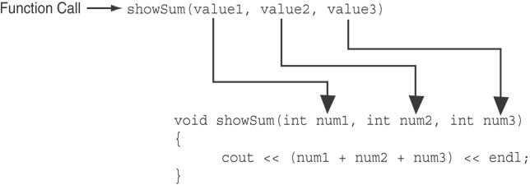
Passing Multiple
Arguments (cont.)
The function call in line 18 passes value1,
value2, and value3 as a arguments to the
function.

Slide 68
In-Class Exercise
What is the output of this program?
01 #include <iostream>
02
03 // Function prototype
04 void func1(double, int);
05
06 int main(){
07 int x = 0; double y = 1.5;
08 cout << x << " " <<y<< endl;
09 func1 (y, x);
10 cout << x << " " <<y<< endl;
11 system (“pause”);
12 return 0;
13 }
14
15 void func1(double a, int b){
16 cout << a << " " <<b<< endl;
17 a=0.0; b=10;
18 cout << a << " " <<b<< endl;
19 }

Slide 69
User-Defined Functions:
Passing Data
Passing by Value
Passing by Reference

Slide 70
Passing Data by Value
Pass by value: when an argument is passed to a function, its value is copied into the parameter.
Changes to the parameter in the function do not affect the value of the argument

Slide 71
User-Defined Functions: Passing Data by Value (cont.)
01 #include <iostream>
02 using namespace std;
03
04 void f( int n ) {
05 cout << "Inside f( int ), the value of the parameter is " << n << endl;
06 n += 37;
07 cout << "Inside f( int ), the modified parameter is now " << n << endl; }
08
09 int main() {
10 int m = 612;
11
12 cout << "The integer m = " << m << endl;
13 cout << "Calling f( m )..." << endl;
14 f( m );
15 cout << "The integer m = " << m << endl;
16 return 0;
17 }

Slide 72
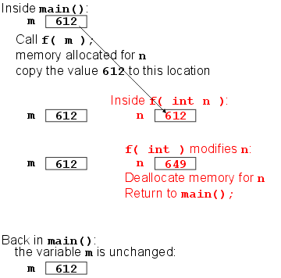
User-Defined Functions: Passing Data by Value (cont.)

Slide 73
Passing Information to Parameters by Value
Example: int val=5;
  evenOrOdd(val);
evenOrOdd can change variable num, but it will have no effect on variable val
val
num
5
5
argument in
calling function
parameter in
evenOrOdd function

Slide 74
Using Functions in
Menu-Driven Programs
Functions can be used
  to implement user choices from menu
  to implement general-purpose tasks:
    Higher-level functions can call general-purpose functions, minimizing the total number of functions and speeding program development time.

Slide 75
The return Statement
Used to end execution of a function
Can be placed anywhere in a function
  Statements that follow the return statement will not be executed
Can be used to prevent abnormal termination of program
In a void function without a return statement, the function ends at its last }

Slide 76
Returning a Value from a Function
A function can return a value back to the statement that called the function.
You've already seen the pow function, which returns a value:
double x;
x = pow(2.0, 10.0);

Slide 77
Returning a Value from a Function
In a value-returning function, the return statement can be used to return a value from function to the point of call. Example:
int sum(int num1, int num2)
{
double result;
result = num1 + num2;
return result;
}

Slide 78
A Value-Returning Function
Return Type
int sum(int num1, int num2)
{
double result;
result = num1 + num2;
return result;
}
Value Being Returned

Slide 79
A Value-Returning Function
int sum(int num1, int num2)
{
return num1 + num2;
}
Functions can return the values of expressions, such as num1 + num2

Slide 80
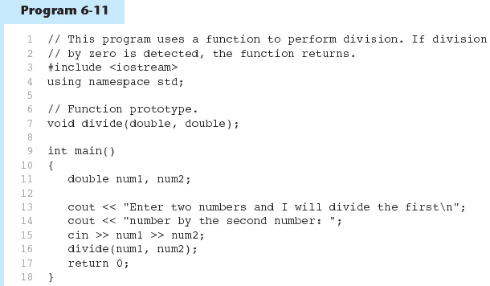
The return Statement - Example

Slide 81
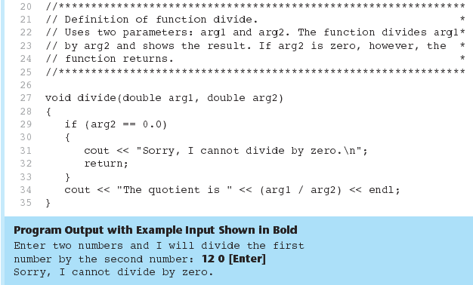
The return Statement - Example
Program 6-11(Continued)
Return to called function

Slide 82
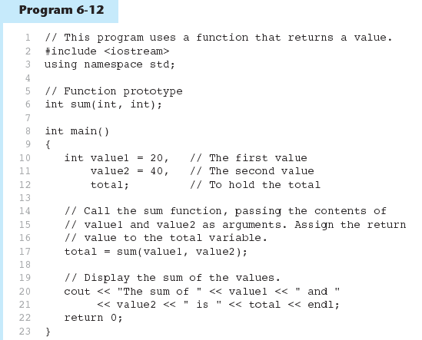
Returning a Value From a Function

Slide 83
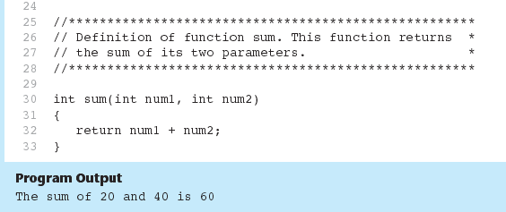
Returning a Value From a Function
Program 6-12 (Continued)

Slide 84
The Structure Chart
main_program
value1
total
value2
sum

Slide 85
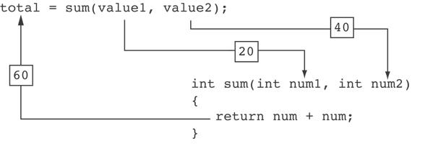
Returning a Value From a Function
The statement in line 17 calls the sum function, passing value1 and value2 as arguments.
The return value is assigned to the total variable.

Slide 86
Returning a Value From a Function
The prototype and the definition must indicate the data type of return value (not void)
Calling function should use return value:
  assign it to a variable
  send it to cout
  use it in an expression

Slide 87
Returning a Boolean Value
Function can return true or false
Declare return type in function prototype and heading as bool
Function body must contain return statement(s) that return true or false
Calling function can use return value in a relational expression

Slide 88
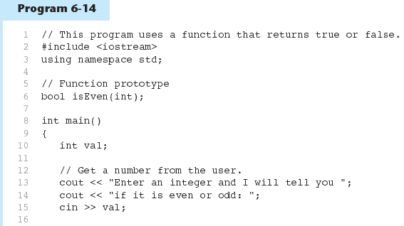
Returning a Boolean Value

Slide 89
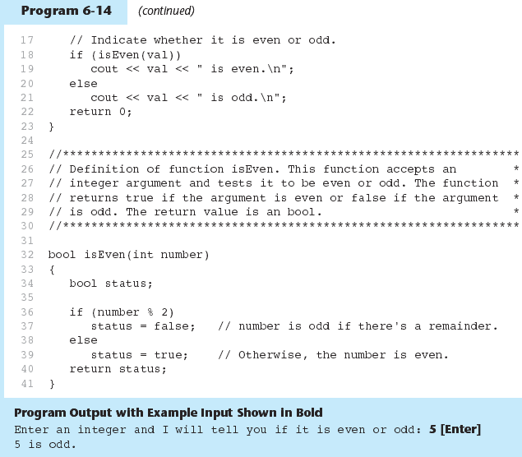
Returning a Boolean Value

Slide 90
In-Class Exercise
#include <iostream>
using namespace std;
void try1(int p);
int try3(int r);
int main()
{ int a=2;
cout << a <<endl;
try1(a);
cout << a <<endl;
int b=3;
cout << b <<endl;
int c=4;
try3(c);
cout << c <<endl;
c=try3(c);
cout << c <<endl;
cout << try3(5) <<endl;
return 0;}
void try1(int p)
{
p++;
cout << p <<endl;
}
int try3(int r)
{
return r*r;
}

Slide 91
In-Class Exercise
Write a function prototype and header for a function named distance. The function should return a double and have a two double parameters: rate and time.
Write a function prototype and header for a function named days. The function should return an integer and have three integer parameters: years, months and weeks.
Examine the following function header, then write an example call to the function.
  void showValue(int quantity)

Slide 92
In-Class Exercise
The following statement calls a function named half. The half function returns a value that is half that of the argument. Write the function.
  result = half(number);
A program contains the following function:
  int cube (int num)
  {
  return num*num*num;
  }
  Write a statement that passes the value 4 to this function and assigns its return value to the variable result.

Slide 93
In-Class Exercise
Write a C++ program to calculate a rectangle’s area. The program consists of the following functions:
  getLength – This function should ask the user to enter the rectangle’s length, and then returns that value as a double.
  getWidth – This function should ask the user to enter the rectangle’s width, and then returns that value as a double.
  getArea – This function should accept the rectangle’s length and width as arguments and return the rectangle’s area.
  displayData – This function should accept the rectangle’s length, width and area as arguments, and display them in an appropriate message on the screen.
  main – This function consists of calls to the above functions.

Slide 94
Local and Global Variables
Variables defined inside a function are local to that function. They are hidden from the statements in other functions, which normally cannot access them.
Because the variables defined in a function are hidden, other functions may have separate, distinct variables with the same name.

Slide 95
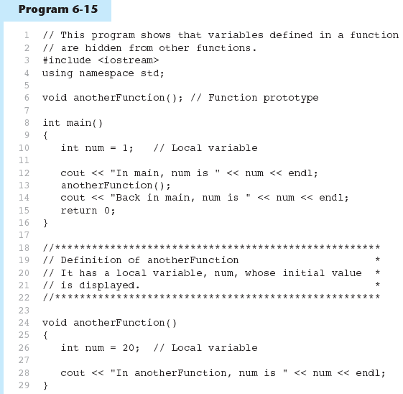

Local and Global Variables - Example

Slide 96
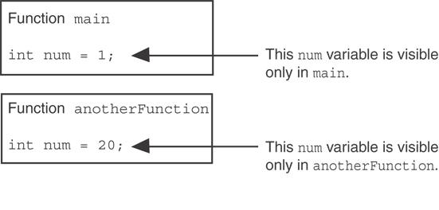
Local and Global Variables - Example
When the program is executing in main, the num variable defined in main is visible.
When anotherFunction is called, however, only variables defined inside it are visible, so the num variable in main is hidden.

Slide 97
Local Variable Lifetime
A function’s local variables exist only while the function is executing. This is known as the lifetime of a local variable.
When the function begins, its local variables and its parameter variables are created in memory, and when the function ends, the local variables and parameter variables are destroyed.
This means that any value stored in a local variable is lost between calls to the function in which the variable is declared.

Slide 98
Global Variables and
Global Constants
A global variable is any variable defined outside all the functions in a program.
The scope of a global variable is the portion of the program from the variable definition to the end.
This means that a global variable can be accessed by all functions that are defined after the global variable is defined

Slide 99
Global Variables and
Global Constants
You should avoid using global variables because they make programs difficult to debug.
Any global that you create should be global constants.

Slide 100
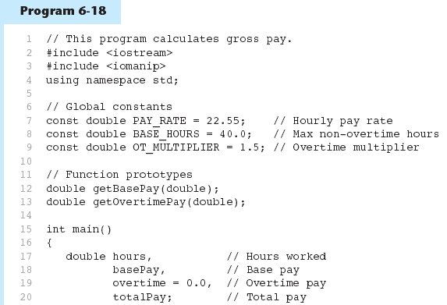
Global Constants – Example
Global constants defined for values that do not change throughout the program’s execution.

Slide 101



Global Constants – Example
The constants are then used for those values throughout the program.

Slide 102
Initializing Local and Global Variables
Local variables are not automatically initialized. They must be initialized by programmer.
Global variables (not constants) are automatically initialized to 0 (numeric) or NULL (character) when the variable is defined.

Slide 103
Static Local Variables
Local variables only exist while the function is executing. When the function terminates, the contents of local variables are lost.
static local variables retain their contents between function calls.
static local variables are defined and initialized only the first time the function is executed. 0 is the default initialization value.

Slide 104
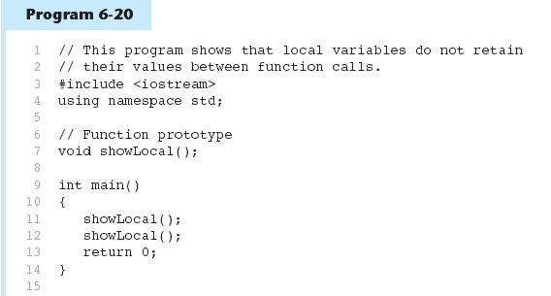
Local Variables - Example

Slide 105
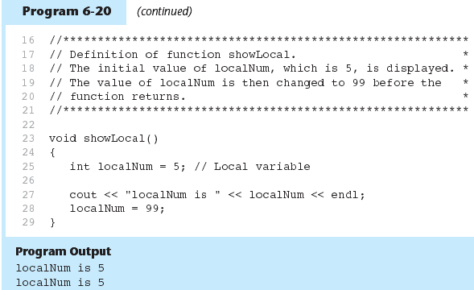
Local Variables - Example
In this program, each time showLocal is called, the localNum variable is re-created and initialized with the value 5.

Slide 106
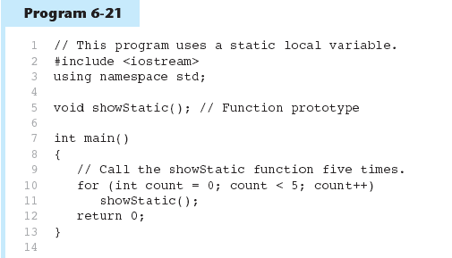
A Different Approach, Using a Static Variable

Slide 107
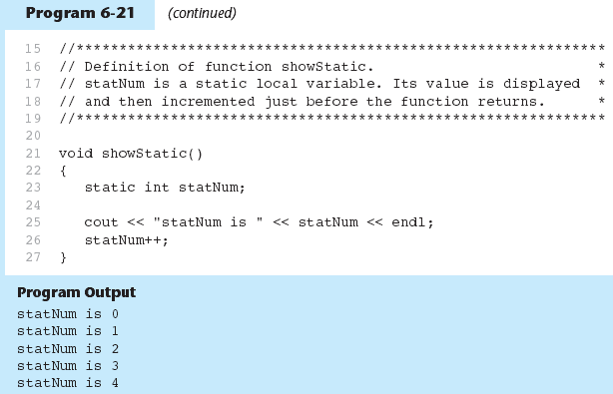
Using a Static Variable - Example
statNum is automatically initialized to 0. Notice that it retains its value between function calls.

Slide 108
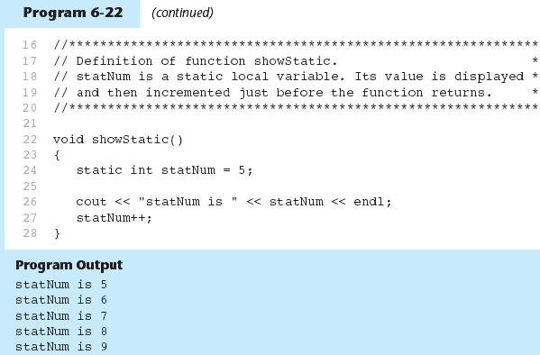
Using a Static Variable - Example
If you do initialize a local static variable, the initialization only happens once. See Program 6-22…

Slide 109
In-Class Exercise
Given the following programs compare the output and reason the output.
#include <iostream>
using namespace std;
void showVar();
int main ( ) {
for (int count=0;count<10; count++)
showVar();
system(“pause”);
return 0;
}
void showVar() {
static int var = 10;
cout << var << endl;
var++;
}
#include <iostream>
using namespace std;
void showVar();
int main ( ) {
for(int count=0;count<10; count++)
showVar();
system(“pause”);
return 0;
}
void showVar() {
int var = 10;
cout << var << endl;
var++;
}

Slide 110
In-Class Exercise
Identify global variables & local variables in the following program. What is the output?
  #include <iostream>
  using namespace std;
  int j = 8;
  int main()
  {
  int i=0;
  cout<<"i: "<<i<<endl;
  cout<<"j: "<<j<<endl;
  system("pause");
  return 0;
  }

Slide 111
Identify global variables, local variables and static local variables in the following program. What is the output?
#include <iostream>
using namespace std;
int j = 40;
void p()
{ int i=5;
static int j=5;
i++;
j++;
cout<<"i: "<<i<<endl;
cout<<"j: "<<j<<endl;
}
int main()
{ p();
p();
return 0;}

Slide 112
Using Reference Variables as Parameters
A mechanism that allows a function to work with the original argument from the function call, not a copy of the argument
Allows the function to modify values stored in the calling environment
Provides a way for the function to ‘return’ more than one value

Slide 113
Passing by Reference
A reference variable is an alias for another variable
Defined with an ampersand (&)
  void getDimensions(int&, int&);
Changes to a reference variable are made to the variable it refers to
Use reference variables to implement passing parameters by reference

Slide 114
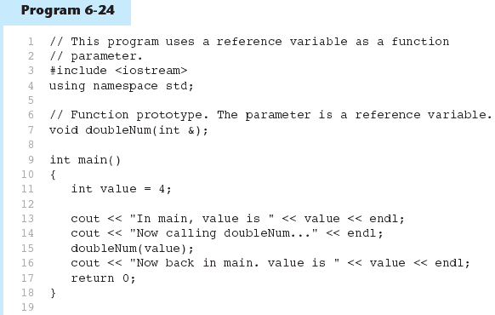
Passing by Reference – Example
The & here in the prototype indicates that the parameter is a reference variable.
Here we are passing value by reference.

Slide 115
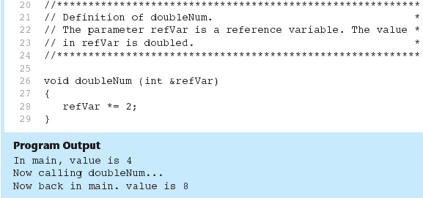
Passing by Reference - Example
Program 6-24 (Continued)
The & also appears here in the function header.

Slide 116
Reference Variables Notes
Each reference parameter must contain &
Space between type and & is unimportant
Must use & in both prototype and header
Argument passed to reference parameter must be a variable – cannot be an expression or constant
Use when appropriate – don’t use when argument should not be changed by function, or if function needs to return only 1 value

Slide 117
#include <iostream>
using namespace std;
void test(int, int&);
int main()
{
int num;
num=5;
test(24, num);
cout<<num<<endl;
test(num,num);
cout<<num<<endl;
test(num*num, num);
cout<<num<<endl;
test(num+num,num);
cout<<num<<endl;
system("pause");
return 0;
}
void test(int first, int& second)
{
int third;
third=first+second*second+2;
first=second-first;
second=2*second;
cout<<first<<" "<<second<<" "<<third<<endl;
}

Slide 118
#include <iostream>
using namespace std;
void test(int&, int&,int,int&);
int main()
{ int a,b,c,d;
a=3; b=4; c=20; d=78;
cout<<a<<" "<<b<<" "<<c<<" "<<d<<endl;
test(a,b,c,d);
cout<<a<<" "<<b<<" "<<c<<" "<<d<<endl;
d=a*b+c-d;
test(a,b,c,d);
cout<<a<<" "<<b<<" "<<c<<" "<<d<<endl;
return 0;
}
void test(int& a, int& b, int c, int& d)
{
cin>>a >> b>> c>> d;
c = a* b+d-c;
c=2*c;
}
The input:
6 8 12 35
8 9 30 45

Slide 119
Default Arguments
A Default argument is an argument that is passed automatically to a parameter if the argument is missing on the function call.
Must be a constant declared in prototype:
  void evenOrOdd(int = 0);
Can be declared in header if no prototype
Multi-parameter functions may have default arguments for some or all of them:
  int getSum(int, int=0, int=0);

Slide 120
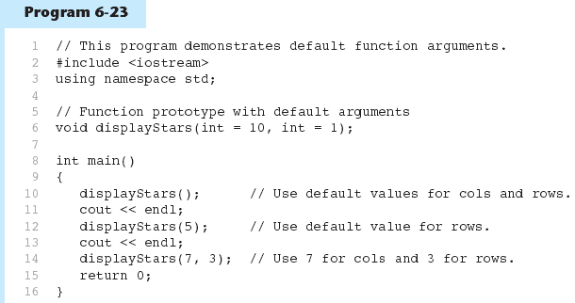
Default Arguments – Example
Default arguments specified in the prototype
(Program Continues)

Slide 121
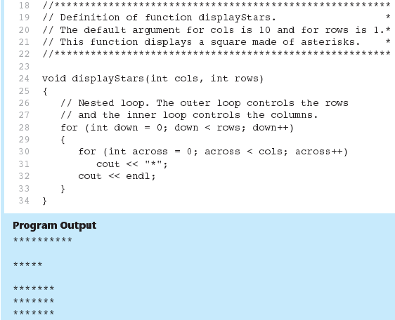
Default Arguments – Example
Program 6-23 (Continued)

Slide 122
Default Arguments
If not all parameters to a function have default values, the defaultless ones are declared first in the parameter list:
  int getSum(int, int=0, int=0);// OK
  int getSum(int, int=0, int); // NO
When an argument is omitted from a function call, all arguments after it must also be omitted:
  sum = getSum(num1, num2); // OK
  sum = getSum(num1, , num3); // NO

Slide 123
Default Arguments
Consider the following function prototype:
void funcExp(int,int, double=55.5,char=‘A’);
The following function calls are legal:
  funcExp(3,4,45.5, ‘B’);
  funcExp(3,4,45.5);
  funcExp(3,4);
The following function calls are illegal:
  funcExp(3,4, ‘C’);

Slide 124
Default Arguments
The following are illegal function prototypes with default arguments:
  void funcOne(int,double=23.45,char, int=45);
  int funcTwo(int=1, int, int=1);
  void funcThree(int, int&=16,double=34);

Slide 125
Consider the following function prototype & function definition:
void testDefaultParam(int , int=5, double=3.2);
void testDefaultParam(int a, int b, double z)
{
int u;
a=a+static_cast<int>(2*b+z);
u=a+b*z;
cout<<"u = "<<a<<endl;
}
What is the output of the following function calls?
testDefaultParam(6);
testDefaultParam(3,4);
testDefaultParam(3,4.5);
testDefaultParam(3,4, 5.5);
testDefaultParam(3.4);

Slide 126
In-Class Exercise
Write a function prototype and function header for a function called compute. The function should have 3 parameters: an int, a double and a long. The int parameter should have a default argument of 5, and the long parameter should have a default argument of 65536. The double parameter should have no default arguments. The parameters no necessarily in the order.
Write a function prototype and function header for a function called calculate. The function should have 3 parameters: an int, a reference to a double and a long. Only the int parameter should have a default argument, which is 47. The parameters no necessarily in the order.

Slide 127
Overloading Functions
Overloaded functions have the same name but different parameter lists
Can be used to create functions that perform the same task but take different parameter types or different number of parameters
Compiler will determine which version of function to call by argument and parameter lists

Slide 128
Function Overloading Examples
Using these overloaded functions,
  void getDimensions(int); // 1
  void getDimensions(int, int); // 2
  void getDimensions(int, double); // 3
  void getDimensions(double, double);// 4
the compiler will use them as follows:
  int length, width;
  double base, height;
  getDimensions(length); // 1
  getDimensions(length, width); // 2
  getDimensions(length, height); // 3
  getDimensions(height, base); // 4

Slide 129
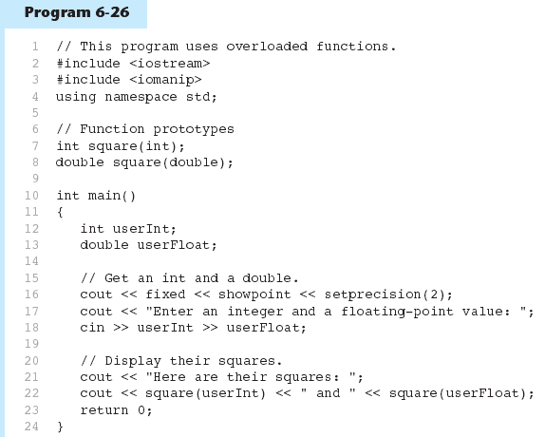
Function Overloading – Example
The overloaded functions have different parameter lists
Passing a double
Passing an int
(Program Continues)

Slide 130
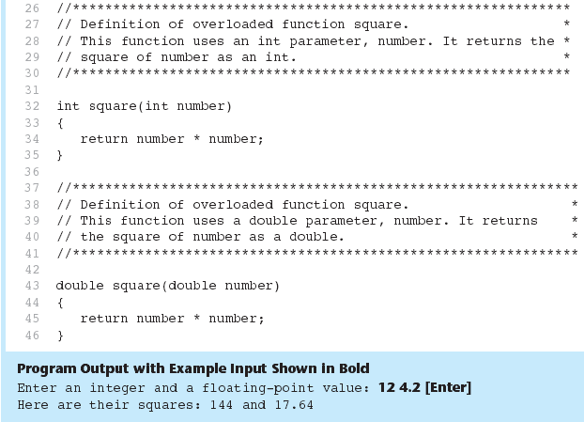
Function Overloading – Example
Program 6-26 (Continued)

Slide 131
The exit() Function
Terminates the execution of a program
Can be called from any function
Can pass an int value to operating system to indicate status of program termination
Usually used for abnormal termination of program
Requires cstdlib header file (Borland)

Slide 132
The exit() Function
Example:
exit(0);
The cstdlib header defines two constants that are commonly passed, to indicate success or failure:
exit(EXIT_SUCCESS);
exit(EXIT_FAILURE);

Slide 133
In-Class Exercise
What is the output for the following programs
#include <iostream>
using namespace std;
void function();
int main(){
function();
cout << "Bye from main.\n";
system (“pause”); return 0;
}
void function(){
cout << "Bye! from function before exit\n";
exit(0);
cout << "Bye! from function before exit\n";
}
#include <iostream>
using namespace std;
int function();
int main(){
function();
cout << "Bye from main.\n";
system (“pause”); return 0;
}
int function(){
cout << "Bye! from function before return\n";
return 0;
cout << "Bye! from function before return\n”;
}

Slide 134
In-Class Exercise
Write a program that calculates the average of a group of test scores, where the lowest score in the group is dropped. It should use the following functions:
  getScore – This function ask the user for a test score, store it in a reference parameter variable, and validate it. For input validation, do not accept test scores lower than 0 or higher than 100. This function should be called by main() once for each of the five scores to be entered.
  calcAverage – This function calculates and display the average of the four highest score. This function should be called just once by main(), by should be passed the five scores.
  findLowest – This function finds and returns the lowest of the five scores passed to it. It should be called by calcAverage function, which uses the function to determine which of the five scores to drop.

